Slide 1

Data Science

Slide 2

What is it?

Slide 3

Definition
Data science is the practice of mining large data sets of raw data, both structured and unstructured, to identify patterns and extract actionable insight from them.

Slide 4
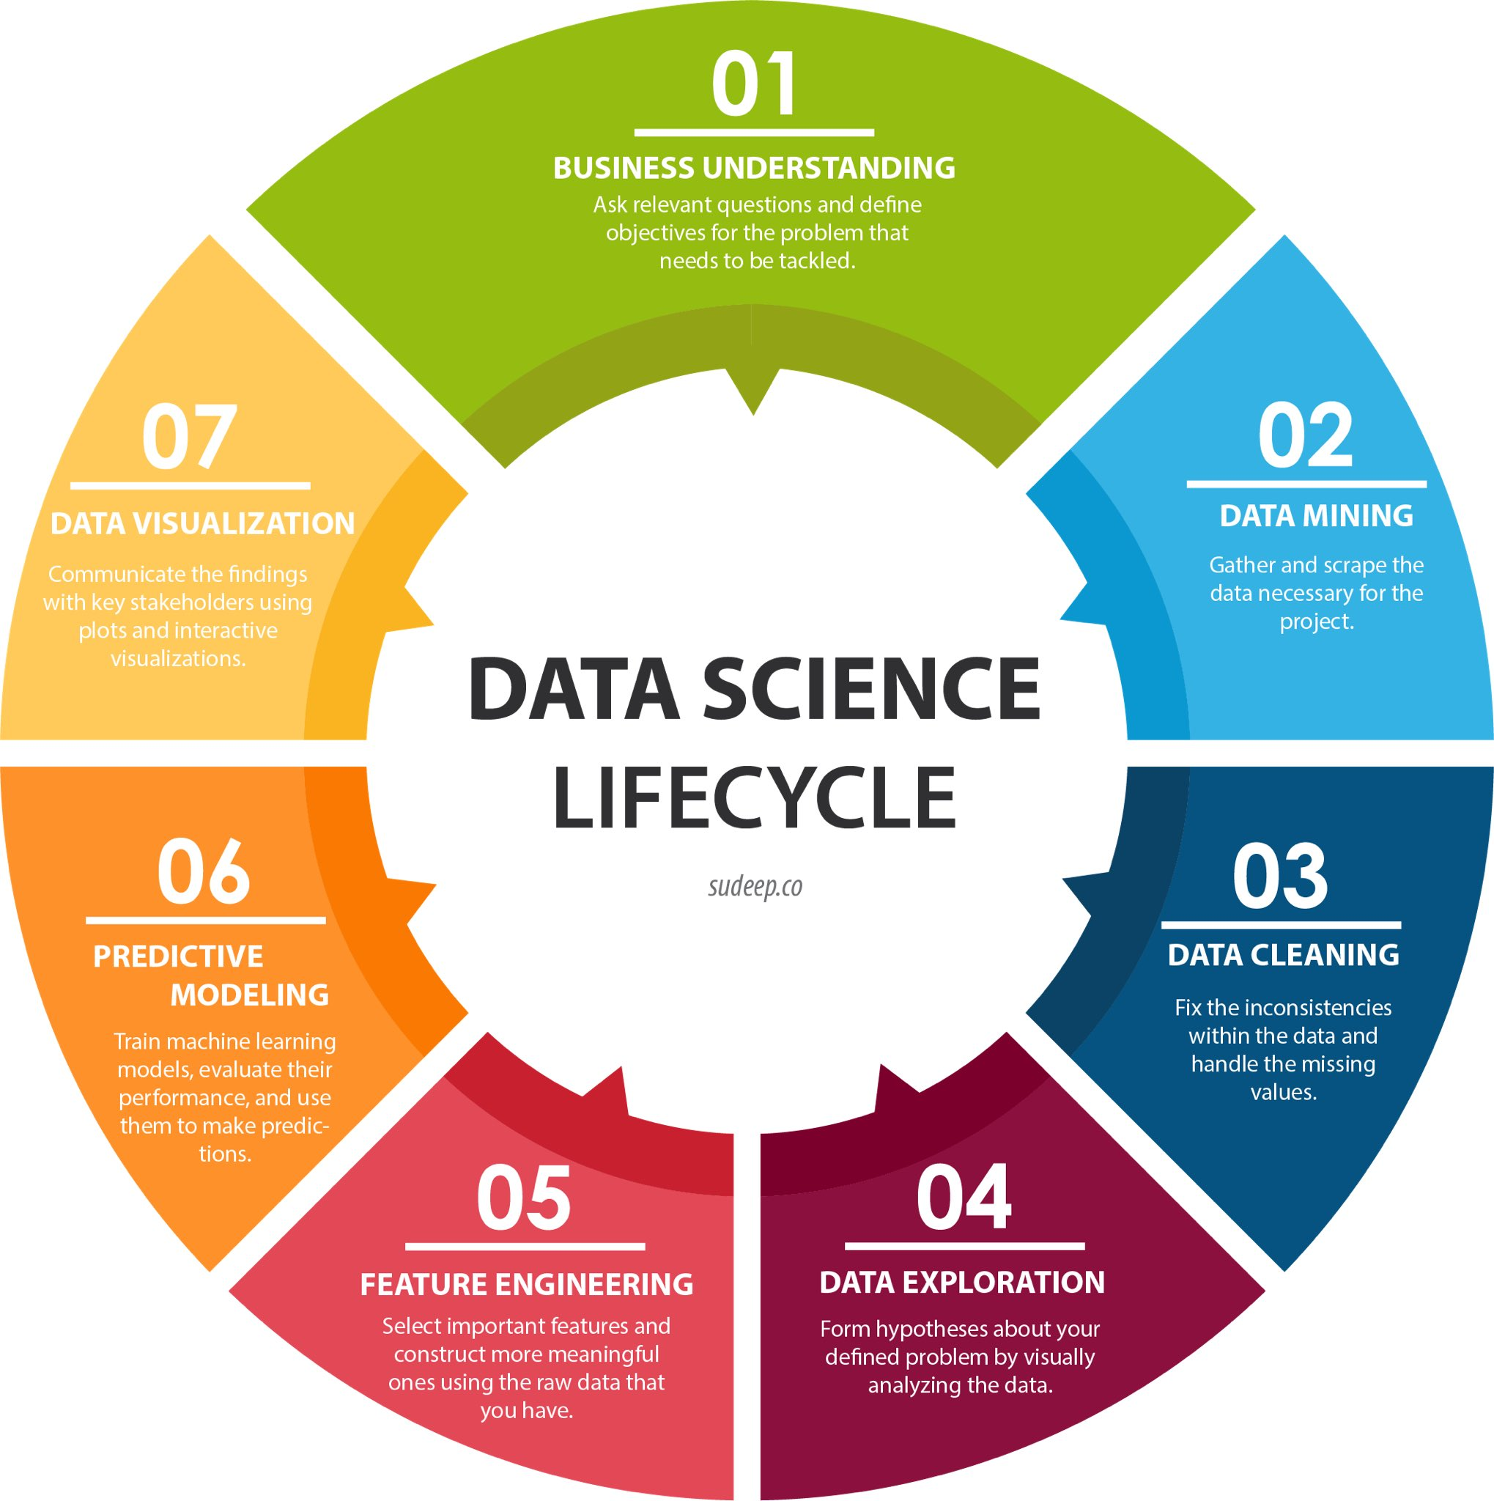
The Magical Cycle

Slide 5
In English:
The science of making decisions… but! Using a computers to do so.

Slide 6
Before we begin…
Lets check our python and math skills

